Slide 1

Summer Classic 2022 Raffle Generator
Abenaqui Professional Shop

Slide 2


About the Designer:
Griffin Quinn
https://www.linkedin.com/in/griffinpaulquinn/
Employed at Abenaqui starting in 2013
B. A. of Computer Science and Economics, Cum Laude, College of the Holy Cross (2022)
5 Years of Coding Experience in Multiple Languages

Slide 3



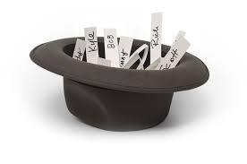
The Raffle Program
Developed in Go
Serves to “Pick Names out of a Hat”

Slide 4
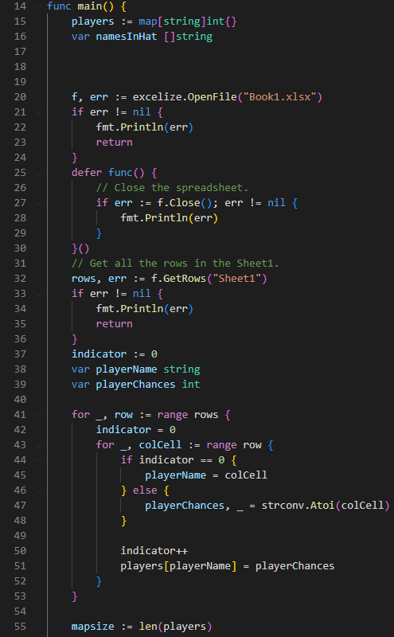
How Does it Work?
First, we use a Go library called “Excelize” to read in player names and chances from an excel document called “Book1.xlsx”
The name of the excel file cannot be changed or else the program will not run
Second, we write our names and chances onto something called a “map” in Go
This serves as our “whiteboard” so that the program can quickly look up player names and chances when filling up the hat

Slide 5
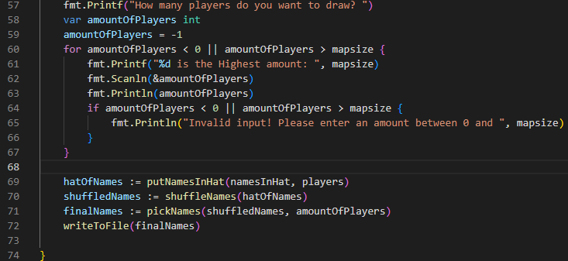
How Does it Work? – Main Function
Next, the program will ask the user how many names to draw. It will not allow the user to draw a number of players that is larger than our list of available players.
Then, as shown in the last few lines, the program places names in the hat, shuffles the hat, picks names out, then writes to a text document of the raffle winners

Slide 6
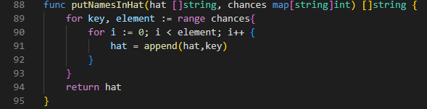
How Does it Work? – Put Names in Hat
The program will go through the “Whiteboard” of players and chances
For each player and corresponding chance, it will populate the “hat” (called a Slice in Go) with that name x amount of times
In this case, X is the amount of chances that player has
For example: Jeremey with 3 chances will be entered into the list 3 times

Slide 7
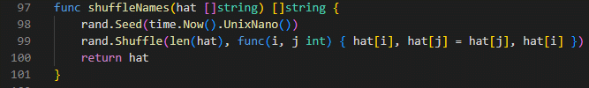
How Does it Work? – Shuffle Names
Uses Go’s built in “rand” and “time” libraries to establish randomness as it shuffles the hat

Slide 8
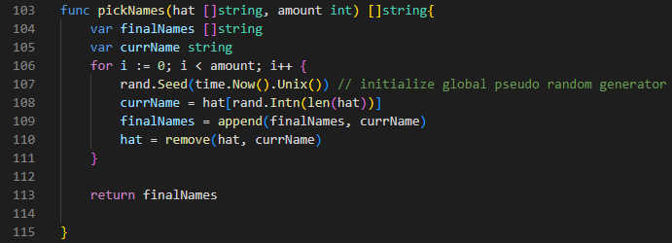
How Does it Work? – Pick Names
Takes the hat and amount of players to pick as parameters
Randomly selects an item from the hat
Appends that player to the list of winners
Goes through the hat and removes any instance of that player so they cannot be picked again
After this, the program will output the list of winners to a “.txt” file

